Slide 1
I am a firm believer that education should be a fun adventure. My two major areas—American History and American Government—lend themselves well to that view. History is a subject about people. All one needs to do is read it like a storybook.
—Patty Emmerich, New Mexico Junior College (New Mexico)

Slide 2
Teaching has always been my passion. I taught elementary school for many years and now have the privilege of teaching future teachers. My students inspire me to continue pursuing excellence in teaching them, as well as to encourage them to pursue excellence in their future careers.
—Ruth Wong, New Mexico Junior College (New Mexico)

Slide 3
I've been with NMSU-A for 14 years. As Executive Assistant for the President, my responsibilities have increased, which has allowed me to grow as a person. My workdays are enjoyable because of my boss and my coworkers. I've always felt it takes everyone to make a place successful.
—Mary Fechner, New Mexico State University Alamogordo (New Mexico)

Slide 4
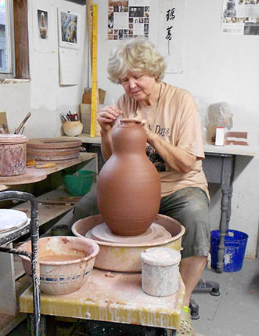
I’ve taught Art for 50 years and have never had a boring moment working with students. I teach the techniques of pottery, sculpture and glaze, ancient arts that remain relevant in a modern technical world. Our work with clay takes us in all directions from design in nature to an appreciation of culture and world history. As a teacher, I am most satisfied when I see students learning to love learning.
—Marty Ray, North Lake College (Texas)

Slide 5
I try to encourage students to see past the classroom and connect to the material in ways that are meaningful to them as individuals, as humans—not just as students. If that sometimes means, for example, teaching methods of rhetorical analysis by analyzing Super Bowl commercials, that’s just a perk.
—Cari Keebaugh, North Shore Community College (Massachusetts)

Slide 6
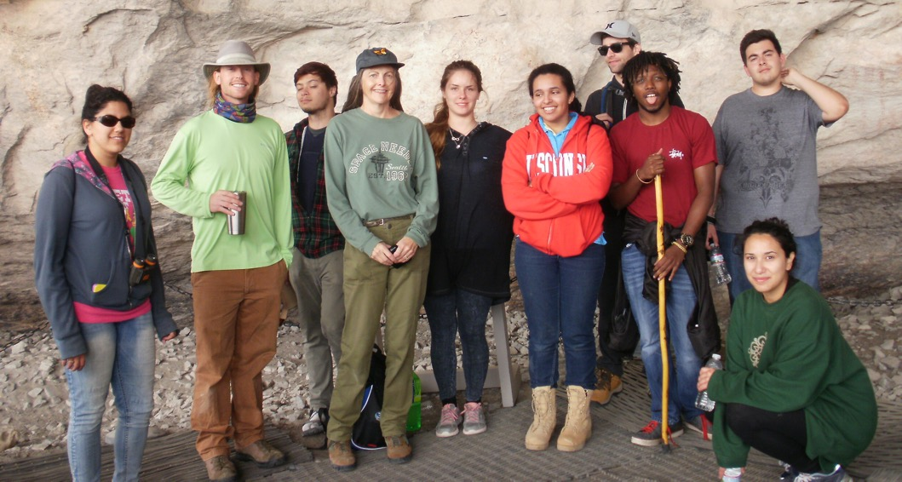
In today’s environment, the role of the librarian as information specialist is often overlooked or misunderstood. Receiving the NISOD Excellence Award affirms how colleagues at my institution understand and value me as a librarian and how I contribute to students’ learning experience, in and outside the classroom.
—Linda Plevak, Northeast Lakeview College (Texas)

Slide 7
Empathy is what I try to bring to the students every class, which means understanding and relating to their feelings, but not sympathy or excusing behavior. Humor in the classroom is important and it is part of the three Hs that I bring to class along with Honesty and Humility.
—John Davidson, Northern Essex Community College (Massachusetts)

Slide 8
It is a joy for me to teach. I have such admiration for my students. They work hard and they have grit. I never close the door on them.
—Patricia Schade, Northern Essex Community College (Massachusetts)

Slide 9
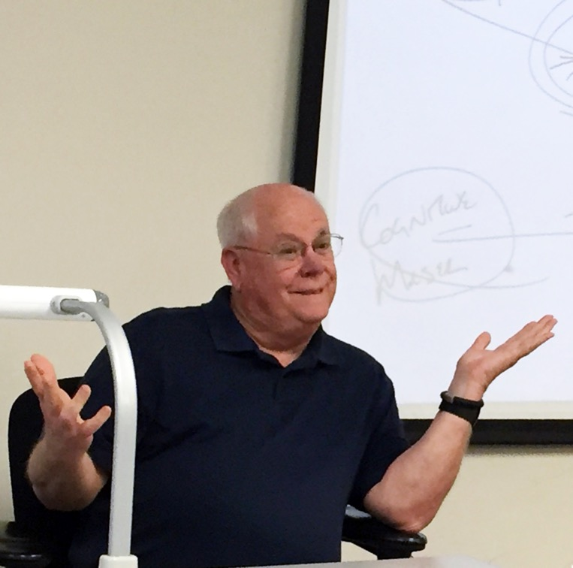
I love the moments when hard-to-pronounce textbook terms, research, and complicated theories get connected to explain “why people do what they do.” I love the teachings of behavioral science with illustrations the students experience in their own lives, causing them to exclaim—not the cherished “Ah-ha!” but a hesitant “Uh-oh!”
—Mark Silkey, Northern Oklahoma College (Oklahoma)

Slide 10
Teaching history goes beyond the classroom. It is keeping the past alive by asking questions, learning, demonstrating, and preserving stories, techniques, homespun traditions, and culture. History is a gift from those before us that should be treasured and shared with all in a community.
—Aliza Novacek-Olson, Northland Community and Technical College (Minnesota)

Slide 11
I enjoy journeying with students from insecurity to comfort with mathematics. I try to be involved with students' learning by learning it again through their eyes, and supporting them through the struggle. Teaching is the mind-work of commitment to students’ excellence, and the heart-work of patience and compassion.
—Heidi Hunt-Ruiz, Northwest Vista College (Texas)

Slide 12
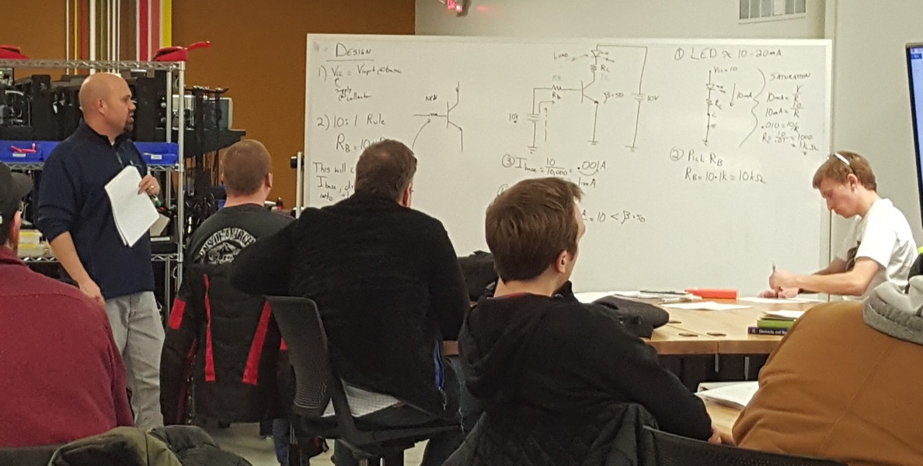
What drives me is the knowledge that we are providing our students with valuable educational experiences and access to cutting-edge technology that will enable them to reach their goals. Whether they decide to continue their education or enter the job market, their success keeps me going.
—Jason Slade, Northwestern Michigan College (Michigan)

Slide 13
My students are my passion. It is important for each student to understand deaf culture and learn to communicate and express themselves in American Sign Language. It is my passion to encourage and connect with each student.
—Gary Davis, Oklahoma State University - OKC (Oklahoma)

Slide 14
Working at Ozarks Technical Community College has provided me with the flexibility to pursue my true passion, which is engaging college students in a meaningful study of history.
—Jennifer Bump, Ozarks Technical Community College (Missouri)

Slide 15
The most rewarding thing about teaching community college students is seeing lives transformed. From traditional students just beginning to explore college-level academics and career choices, to nontraditional students returning to education after many years away, everyone who succeeds becomes more confident, more knowledgeable, more highly skilled, and more employable.
—David Fotopulos, Ozarks Technical Community College (Missouri)

Slide 16
Whether I’m helping a student just out of high school understand college, or a student who is in their 60s who has not been to school in many years and is trying to figure out Microsoft Office, these students, in this environment, make me excited to come “home” every day!
—Michael Holik, Ozarks Technical Community College (Missouri)

Slide 17
If we believe in the idea that everyone should have an opportunity to succeed in life, then providing every student with quality education is the best thing we can do to make that ideal a reality.
—Matthew Simpson, Ozarks Technical Community College (Missouri)

Slide 18
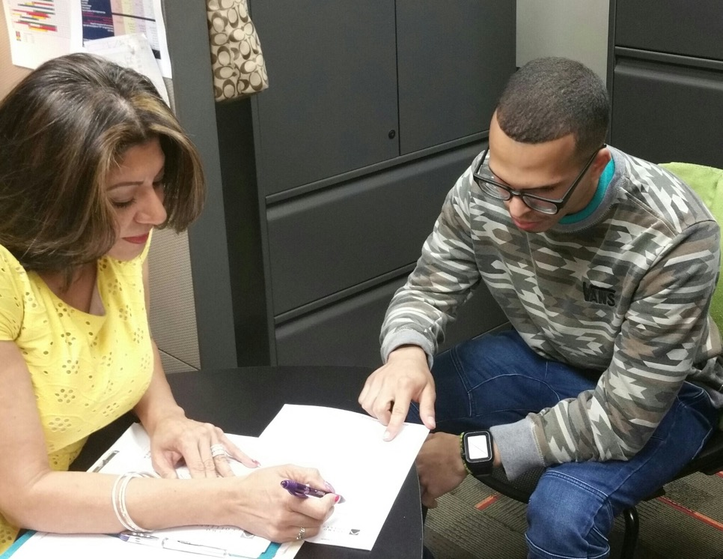
Working with our American heroes inspires me on a daily basis. Our veterans have served our country in a dignified and honorable way. Serving them for serving us is an honor and a privilege. Seeing our veterans cross the stage is a proud moment as a VA advisor.
—Laurie Medina, Palo Alto College (Texas)

Slide 19
I am motivated to teach students because I want to help produce individuals who can make positive contributions to our community. I tell my students all the time that when they know better, they should do better. I am lucky because I can help them to “know better.”
—Matilda Staudt, Palo Alto College (Texas)

Slide 20
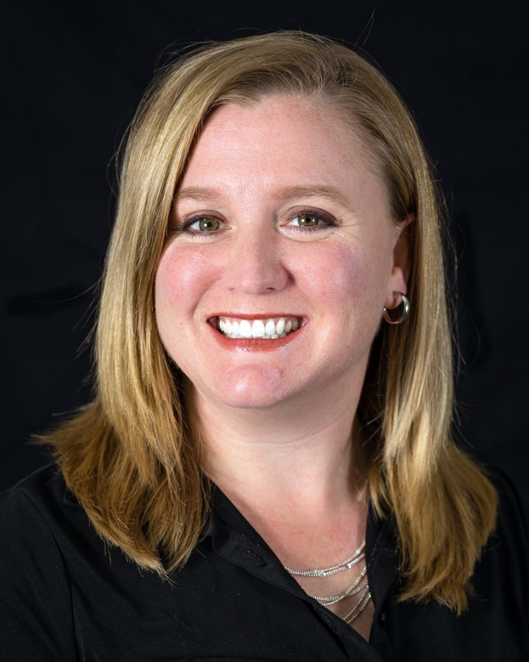
Student and teacher successes are not independent of each other. I measure the students’ and my success by the same standards. Success is measured by the students’ ability to think and communicate more effectively and to understand and apply the concepts learned in class to everyday life.
—Toni Burkhalter, Parkland College (Illinois)

Slide 21
Classroom management and a good student rapport are essential elements to the success of our students, as individuals and as a group. In order to keep my students engaged and effective, I use hands-on activities and peer-to-peer teaching.
—Sonja McCall-Strehlow, Pensacola State College (Florida)

Slide 22
I am inspired to teach by knowing that I am helping students learn skills and knowledge required to obtain a degree in a healthcare or allied healthcare field so they can provide needed care to others. Words of wisdom: Always take responsibility for your actions and wash your hands often!
—Mitzie Sowell, Pensacola State College (Florida)

Slide 23
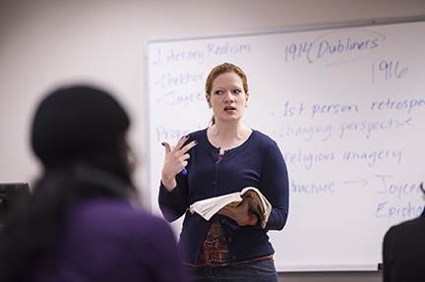
Stephen King said, “We never know which lives we influence, or when, or why.” I strive to create opportunity after opportunity for this influence, and thereby education—in the classroom, online, and in my office. Engaged presence is a type of persistence necessary for a great educator.
—Amber Brooks, Perimeter College at Georgia State University (Georgia)

Slide 24
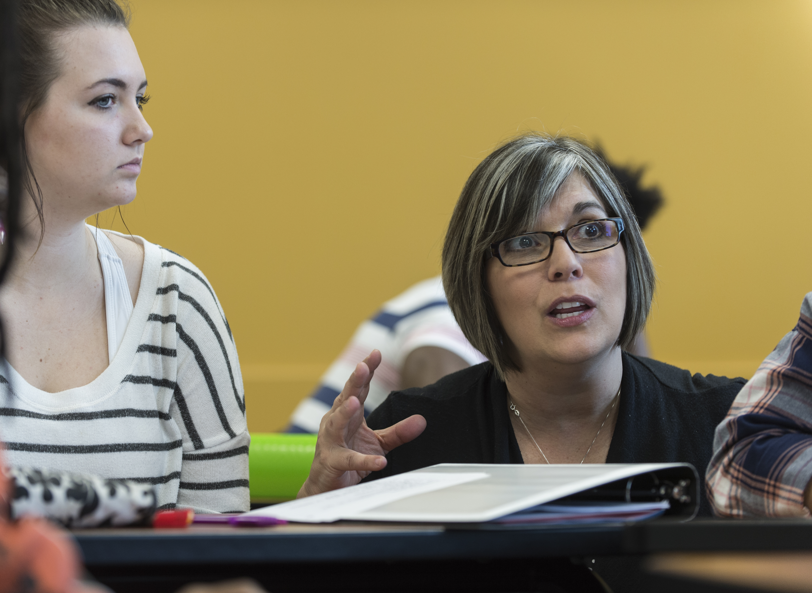
—Jane Hercules, Perimeter College at Georgia State University (Georgia)

Slide 25
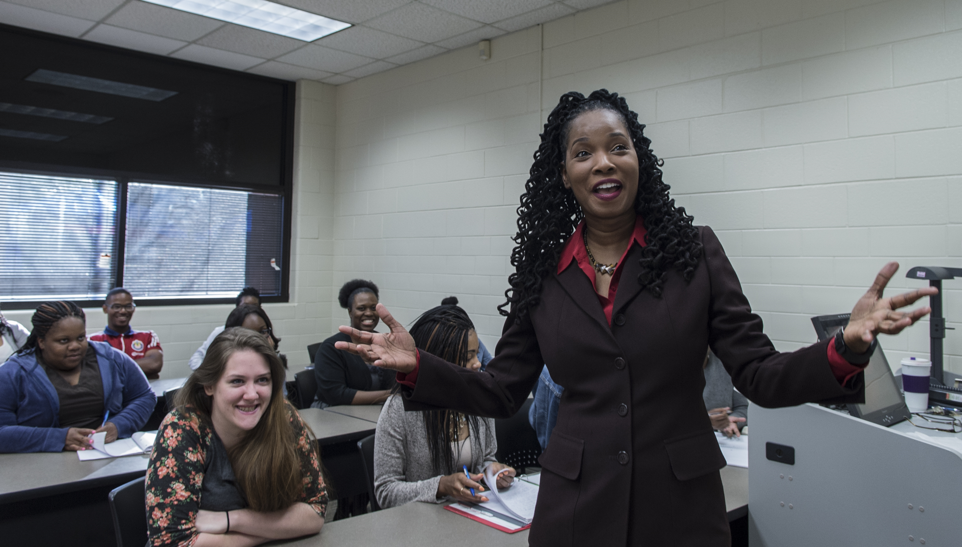
—Nicolette Rose, Perimeter College at Georgia State University (Georgia)

Slide 26
Amalia promotes and attends evening fundraising events for the DACA students and has found several community donors to help students financially. She calls students often to check on them when instructors are concerned, and past students contact her to thank her for helping them succeed at Phoenix College and beyond.
—Amalia Villegas, Phoenix College (Arizona)

Slide 27
Students should not be relegated to learning one way. Traditional lecture is important, but I prefer to use project-based learning, group work, games, brainstorming sessions, and hands-on learning to help my students learn and grow. I am very proud of some of the innovative approaches I have developed.
—Clay Sprouse, Piedmont Technical College (South Carolina)

Slide 28
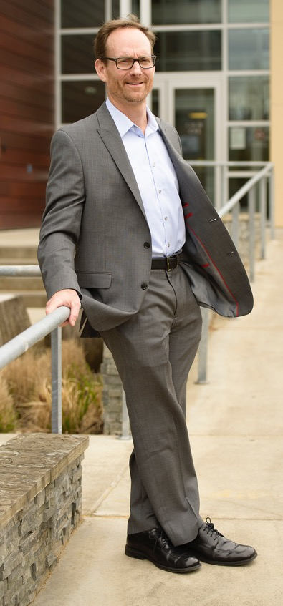
Be driven to ensure student access and success. Be willing to work hard to create positive change in your college. Take data-informed risks. Acknowledge gaps in student success and realign resources to alter them. Work collaboratively. Understand and embrace the reality that change is only going to accelerate. Breathe!
—Thomas Broxson, Pierce College (Washington)

Slide 29
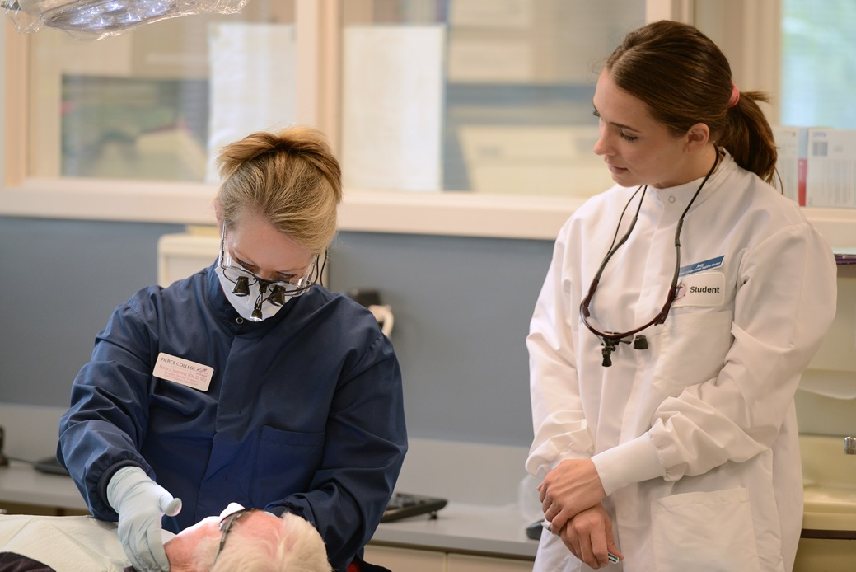
Turning dreams into goals requires a responsibility to be greater than you imagine. Booker T. Washington said, “Few things help an individual more than to place responsibility upon him, and to let him know that you trust him.” Trust yourself to make a positive difference and inspire people.
—Monica Hospenthal, Pierce College (Washington)

Slide 30
Effective instruction involves going beyond the walls of the classroom to give students experiences that lead them to become motivated lifelong learners and engaged citizens. The human brain learns best through social interaction and experience. Let's get out of the classroom and teach in the way the brain learns.
—Samantha Chauncey, Pitt Community College (North Carolina)

Slide 31
It may sound cliché, but seeing students lift themselves up and gain a true appreciation for learning means everything to me. To all the aspiring teachers out there . . . is it a lot of work? It is. Is it frustrating at times? It is. Is it worth it? Every day.
—Anthony Cornett, Polk State College, Winter Haven (Florida)

Slide 32
I am extremely honored to be a 2016 recipient! I believe leadership is something that is seen and not heard. That is why I strive every day to promote creativity and advancement, and to push those I encounter to the next level.
—Lindsey Curley, Prince George's Community College (Maryland)

Slide 33
—Angela Mathis, Prince George's Community College (Maryland)

Slide 34
Inspiration and motivation come to me from faces. Happy or sad, my students' faces—reflecting hardships in their studies or successes with their grades—drive my teaching. The words of wisdom I impart are easy to remember: Always forge forward. Never dwell on the past; it cannot be changed. Tons of opportunities await you!
—Victor Somma, Quinsigamond Community College (Massachusetts)

Slide 35
I want students to feel connected. They need to feel connected to each other in the class, with the course content, and with the instructor in order to succeed with the course material. My reason for teaching is to aid in these connections.
—Annie Clement, Rochester Community and Technical College (Minnesota)

Slide 36
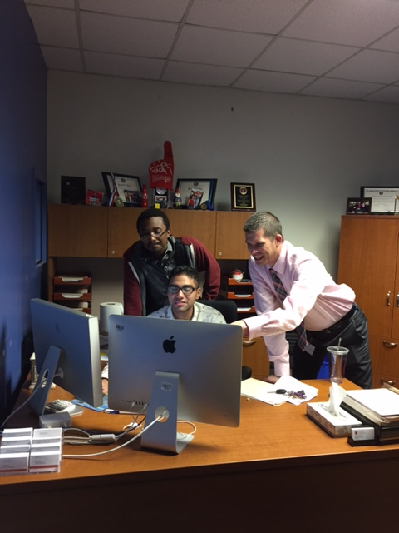
I get motivated and inspired each time I see a student have their own “Aha!” moment. In that moment I get to see a student make an investment in their personal success and have a personal paradigm shift to “if not me, who; if not now, when”.
—Mark Bigelow, San Antonio College (Texas)

Slide 37
Working in Facilities Management, there's always an issue to address, a problem to solve, or a project to plan. The pressure is constant. When I start to feel burned out, I remind myself that at some point the students feel the same way. Stay focused and persevere.
—Debra Garcia, San Antonio College (Texas)

Slide 38
I am inspired by the College TEAM approach: “To help students achieve their full potential by preparing them to graduate, transfer, or enter the workforce with effective critical-thinking skills, communication proficiency, leadership ability, personal and civic responsibility, performance proficiency, and the ability to work effectively in teams.
—Rose Marie Gonzales, San Antonio College (Texas)

Slide 39
No award is ever the product of a sole individual. With respect I acknowledge all Mortuary Science students who have overcome numerous academic demands to serve those facing the death of a loved one. Through your stories, you have taught me how to become a better educator and funeral practitioner.
—Jose Luis Moreno, San Antonio College (Texas)

Slide 40
From the first day of class, I tell my students that I want them to find a career they will love as much as I do mine. I have the opportunity to touch lives and make a difference. It is a privilege to play a part in each student’s journey.
—Kara Mowrey, San Antonio College (Texas)

Slide 41
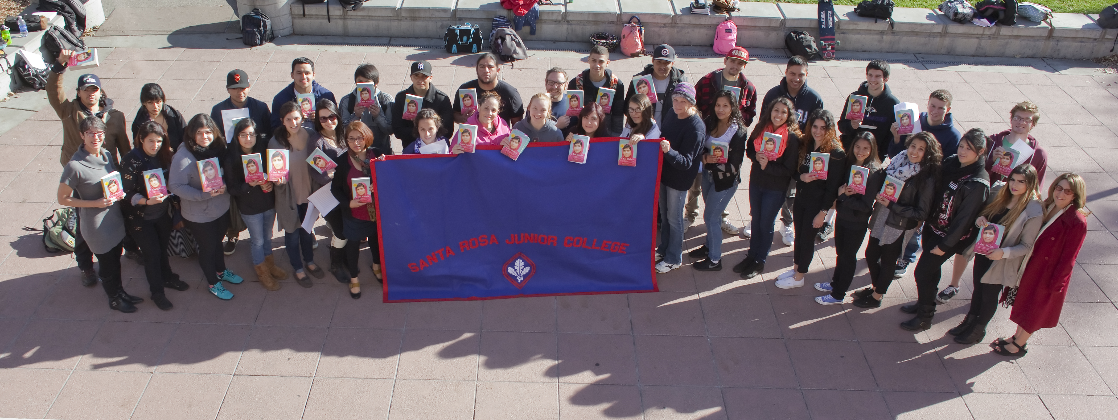
From the first day of class, I tell my students that I want them to find a career they will love as much as I do mine. I have the opportunity to touch lives and make a difference. It is a privilege to play a part in each student’s journey.
—Ann Foster, Santa Rosa Junior College (California)

Slide 42
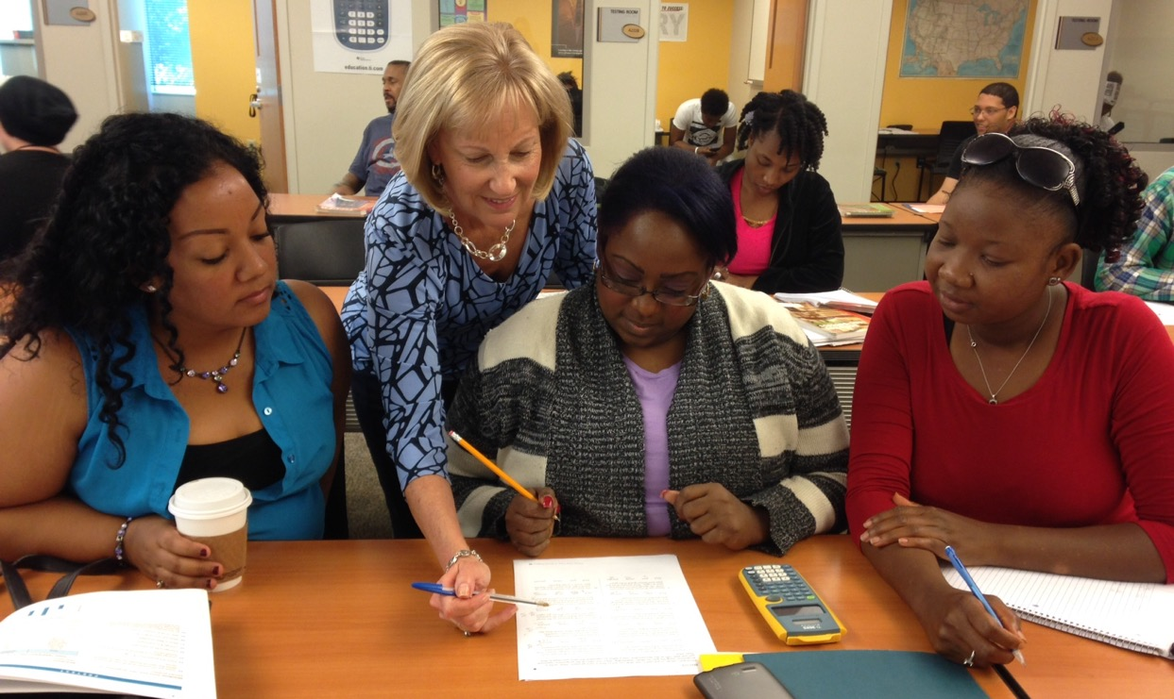
—Cynthia Godby, Seminole State College of Florida (Florida)

Slide 43
Having a passion to teach and knowing that what I do in the classroom would certainly make a difference in my students’ lives are the sources of my motivation to do what I love—TEACH.
—Laila Nimri, Seminole State College of Florida (Florida)

Slide 44
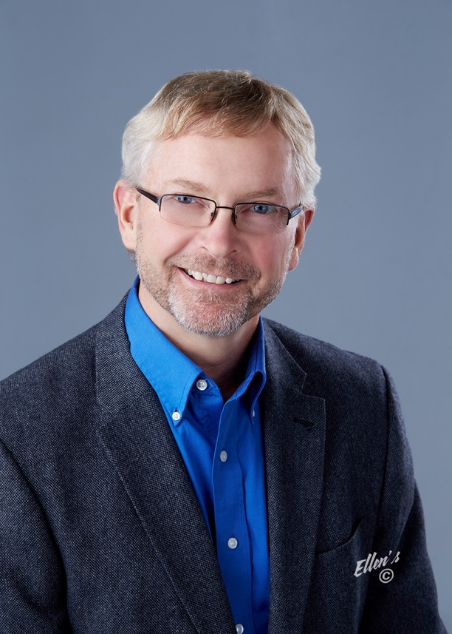
I am humbled to stand before the community with the task of creating change in Career and Technical Education. I have a superior team of individuals, students, and community leaders who make each day an amazing experience in building the future of Kansas and the region.
—Larry McLemore, Seward County Community College (Kansas)

Slide 45
Laboratory science is my passion. I am privileged to be able to help these students begin their studies in the field of laboratory medicine. I am inspired by my students' desire to learn attention to detail, medical ethics, procedure, and quality patient care.
—Jamie Titus, Seward County Community College/ATS (Kansas)

Slide 46
I display energy, passion, and creativity when teaching or preparing activities with the Environmental Awareness Club. I use several effective pedagogical techniques. I hope to continue working at SGSC for many years. As a Latin American faculty member, my smile is the first makeup I apply each day. Thank you everyone for this award.
—Rosa Guedes, South Georgia State College (Georgia)

Slide 47
Learning new skills can be difficult, but it shouldn't seem impossible. Create an environment of respect, fairness, integrity, and passion for all that you do, and students will believe a new skill and confidence in life is possible. Making a difference in a student's life is truly a lifetime reward.
—Randy Jones, Southern Alberta Institute of Technology (Alberta)

Slide 48
Two things that I believe lead to greater student engagement and success are: (1) If you want learners to be passionate and excited about the material, you need to bring the passion and excitement to class yourself, and (2) Don’t talk “at” learners; talk “to” learners.
—Dean Radke, Southern Alberta Institute of Technology (Alberta)

Slide 49
Students come to class with different levels of academic knowledge and life experiences. Celebrating rather than overlooking this allows for a classroom climate that personalizes the learning environment and captures student interest.
—April Ruhmann, Southwest Texas Junior College (Texas)

Slide 50
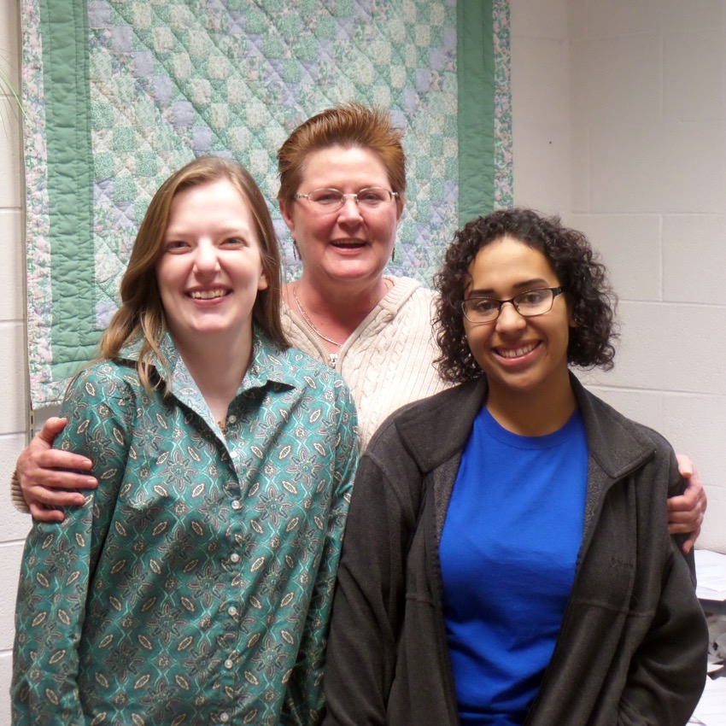
I enjoy learning and I want others to do so as well. The flushed face of intense concentration and the gleam of insight thrill me, but listening, accepting, and engaging with others allows us to witness positive change, internally and externally. That builds peace and benefits us all.
—April Hess, Southwest Virginia Community College (Virginia)

Slide 51
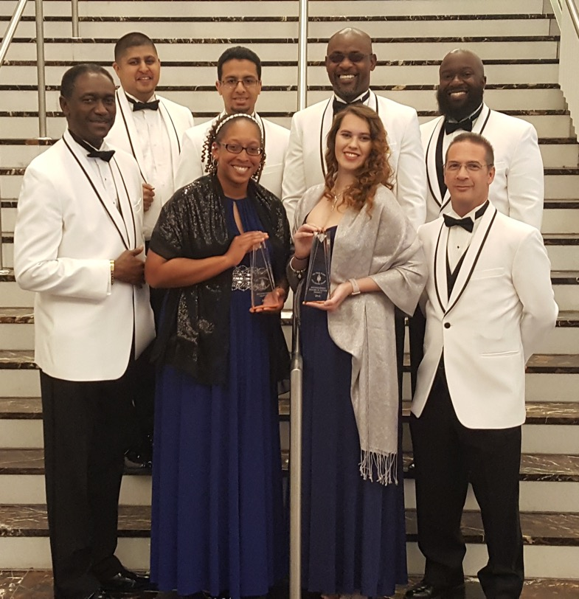
Judge me on what my students can do after my class, because any educator can teach a student to pass a course, but not necessarily prepare her or him for the next level.
—Michael Odu, Southwestern College (Florida)

Slide 52
I am inspired by going on the journey with my students. I am a business technology instructor whose students vary from fragile students to those who excelled in previous endeavors. I absolutely marvel at the journey of each and every student as they grow in skills, confidence, and self-expectations.
—Donna Evenson, Spokane Falls Community College (Washington)

Slide 53
Teaching is an all-encompassing task involving hard work, dedication, interest in your chosen field of study, and nurturing of student aspirations. Teaching is like a Rubik's Cube; when you can place all the colors in their rightful place, you have created a lifelong learner.
—Judith Throop, Spokane Falls Community College (Washington)

Slide 54
Benjamin Franklin said, “Tell me and I forget, teach me and I may remember, involve me and I learn.” Thus it is important to engage every student in the class discussion. Mathematics is its own language, but it does not have to be a language that is foreign.
—Marie St. James, St. Clair County Community College (Michigan)

Slide 55
Teachers have more influence than we realize. Students watch our actions. I would hate to think they leave my class thinking, “Now I know what not to do.” I want them to be the best nurses possible, but I am more concerned that they become the best people possible.
—Jill DeHoog, St. Philip's College (Texas)

Slide 56
I have the honor and privilege to work at an outstanding institution that has made the difference in the lives of students for over 118 years!
—Lacy Hampton, St. Philip's College (Texas)

Slide 57
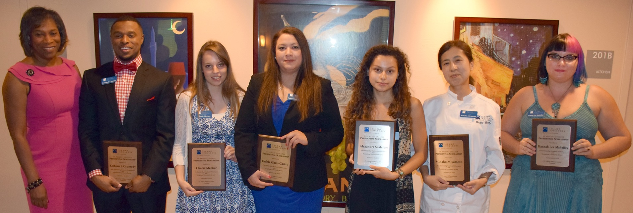
—Adena Loston, St. Philip's College (Texas)

Slide 58
Thank you, NISOD, for this award, and to St. Philip's College for nominating me for the award. I have great respect for the faculty and staff at St. Philip's College. I will continue to do what I do. It is what I do and I love what I do.
—Solomon Nfor, St. Philip's College (Texas)

Slide 59
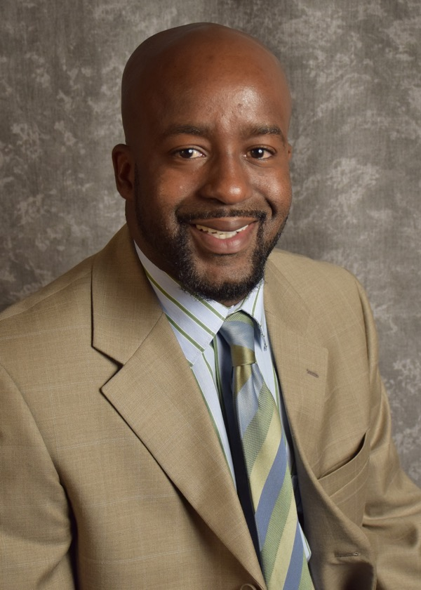
I am inspired by our students every day to help them break down barriers so they can achieve their dreams.
—Joshua Scott, St. Philip's College (Texas)

Slide 60
“Moonlight floods the whole sky from horizon to horizon; how much it can fill your room depends on the windows.” —Rumi. I endeavor to make my students as dangerous as possible, learning to seek out information and to test its validity.
—Anastasia Bojanowski, State College of Florida (Florida)

Slide 61
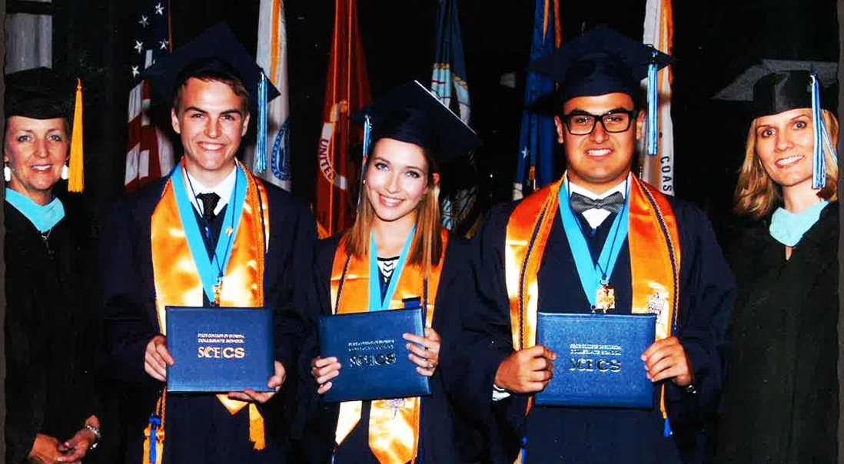
Teaching is a balance between finding a way to help your student connect with what they need to move forward, and also coaching them to navigate the uncharted path alone.
—Kelly Monod, State College of Florida (Florida)

Slide 62
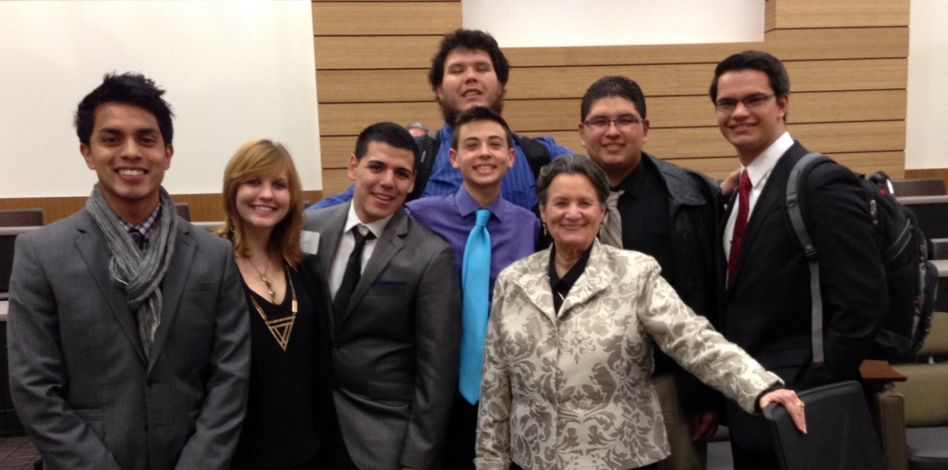
What inspires and motivates me in my work is having the privilege of sharing my knowledge with students, helping them succeed is the opportunity of a lifetime! It is very rewarding to witness students achieve their dreams and know that you have been part of the process.
—Noema “Amy” Santos, State College of Florida (Florida)

Slide 63
As a research librarian, I want to make sure that students understand how to find, evaluate, synthesize, and document authoritative information for their assignments. But more importantly, I have a responsibility to impart the research skills students will need when they go on to an university and throughout their careers.
—Mark Marino, State College of Florida, Manatee-Sarasota (Florida)

Slide 64
Receiving the NISOD award is a tremendous honor. Receiving this prestigious award is an affirmation that dedication to student success, challenging aspiring minds, and turning every possible opportunity into a teaching moment is vital to our students' success, and is alive and well at Tallahassee Community College.
—Larry Bourdeau, Tallahassee Community College (Florida)

Slide 65
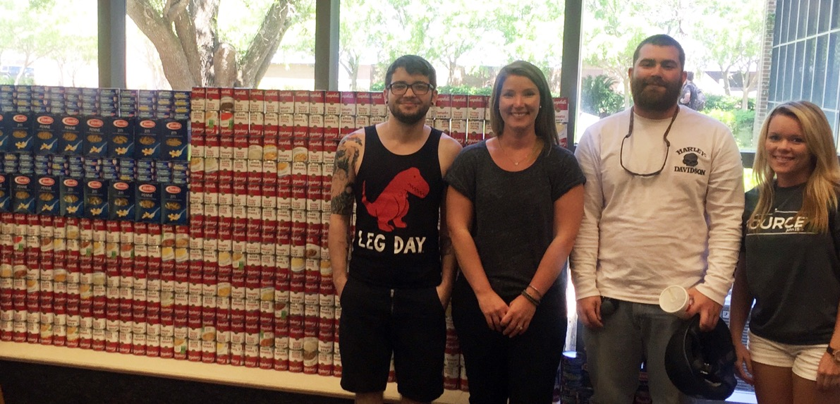
I believe in service learning. I am driven by the opportunity for my students to see the humanities at work in the world they live in, and for them to understand they have skills and knowledge to contribute to make our communities better.
—Lindsey Smitherman-Brown, Tallahassee Community College (Georgia)

Slide 66
A teacher is who I am, and teaching is what I do with all of my heart. Teaching does not feel like work to me. I am so thankful to Tarrant County College for giving me the opportunity, and to NISOD for bestowing upon me this teaching excellence honor.
—Tyson McMillan, Tarrant County College (Texas)

Slide 67
“The mind is not a vessel to be filled, but a fire to be ignited.”
—Patrick Finnegan, Temple College (Texas)

Slide 68
In education, no matter our role, we are tools to the acquisition of knowledge and skills for the students. It's incumbent upon us to ensure that the student owns his or her own education. I always try to impress upon the students that, “Nobody cares more about your education than you.”
—Stephen Phelps, Temple College (Texas)

Slide 69
Love learning. Teach your students to love learning. Base success on what your students achieve, and remember you are part of making their dreams come true.
—Aurora Wold-Krogmann, Temple College (Texas)

Slide 70
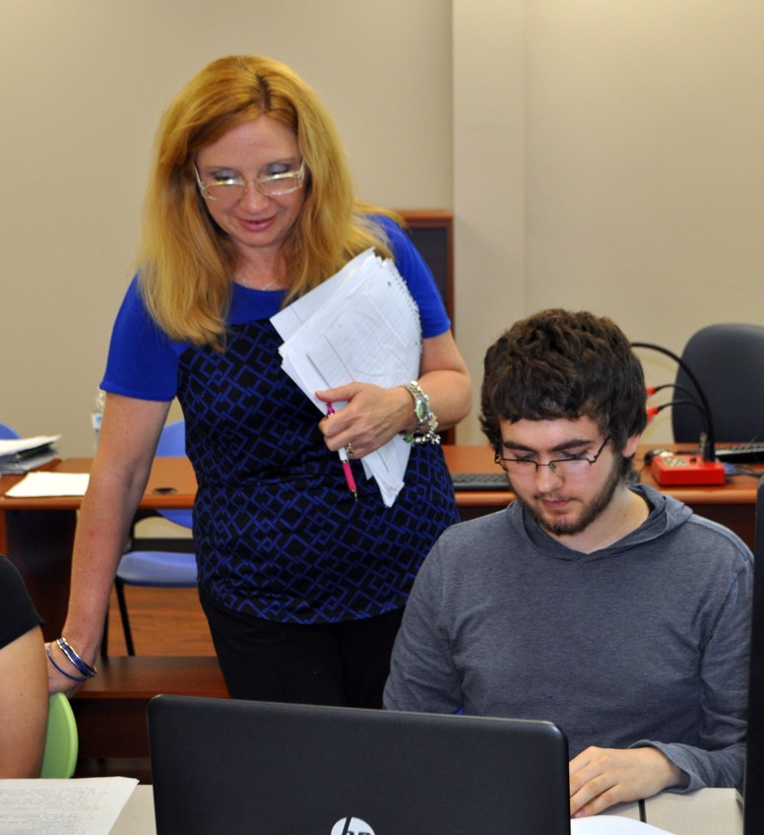
Understanding each student’s unique situation and the crucial role I play in that process is motivating. Beyond being prepared to teach the concepts, as an educator I must relate to my students by recognizing their weaknesses, strengths, failures, and successes. Effectively communicating with them to encourage and teach is essential.
—Melisa Jones, Texarkana College (Texas)

Slide 71
I entered the world of education to help make a difference in the lives of students. Working at Texarkana College, I am able to not only impact the life of a student, but to make a huge difference in their life, as well as the lives of their family members.
—Donna McDaniel, Texarkana College (Texas)

Slide 72
Nontraditional students, single working mothers, and students who are the first in their families to go to college inspire me. They show up every day and overcome so many obstacles. So I work tirelessly, making sure they have the services and programs they need to build upon their strengths and become successful.
—Adele Clinton, Texas State Technical College (Texas)

Slide 73
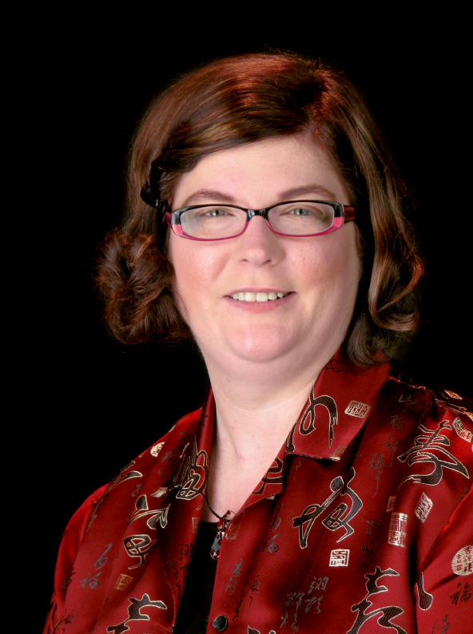
Every day is an opportunity to change a life. If we miss the chance to impact the lives of our students and community we have failed. Service to others, and making a positive impact is the core of leadership and indeed education for me.
—Hannah Love, Texas State Technical College (Texas)

Slide 74
Safety is everyone's responsibility, but we must work as a team to collectively adapt to ongoing changes in our environment and in the way we do things, all with the mission of ensuring and maintaining workplace safety. As the saying goes, “Safety is no accident.”
—Enrique Carrillo, Texas State Technical College-Harlingen (Texas)

Slide 75
The journey to turn on the light is an adventure beyond all comprehension. It is an adventure that we embark upon every day. There are no words to express the look on a student's face when the light comes on.
—Edward Chaney, Texas State Technical College-Marshall (Texas)

Slide 76
It is consistently satisfying to aid our students in getting from point A to point B in life. The chance to help facilitate that in any way brings with it tremendous reward.
—Steve Clements, Tyler Junior College (Texas)

Slide 77
Find a way to connect with students. Do whatever it takes to engage them in active, relevant learning. Coach students in how to learn. Encourage, mentor, and guide. Offer advice, even if unsolicited. Above all, be passionate about teaching and use subject matter to chase students down the path of learning!
—Linda Gary, Tyler Junior College (Texas)

Slide 78
The teacher you most remember is one who inspired you to become a better person—one who demonstrated qualities you want to possess, one who exhibited a passion for learning, one who was genuine. Teachers are the role models of the world.
—Carrie Hobbs, Tyler Junior College (Texas)

Slide 79
The main factor that inspires and motivates me in my work is the love of learning. I try to walk away from every encounter with something new. Never feel you cannot learn more if you are willing to exchange ideas with those around you—students, colleagues, and strangers.
—Byron Howell, Tyler Junior College (Texas)

Slide 80
We are fortunate to touch the future with workforce training in fields of public safety. We train them today and they serve us tomorrow.
—Thomas Johnson, Tyler Junior College (Texas)

Slide 81
Forty years of community college experience has taught me:
Do your best—treat every day as an “interview.”
Look for the best in others.
You get what you reflect—be positive in your attitude and that is usually what you will get in return.
—Paul Monagan, Tyler Junior College (Texas)

Slide 82
Only those who've learned to examine history can draw lessons from it. As a professor, my job is not to indoctrinate, but to show how to understand, analyze, and explain the past. How did things get as they are? When students can make history their own, I have succeeded.
—Jeffrey Owens, Tyler Junior College (Texas)

Slide 83
Witnessing students experience true learning and knowing they will have a better future because of the work you do are the pearls of teaching. This profession is so important and a gift of which to be a part.
—Melanie Ward, Tyler Junior College (Texas)

Slide 84
Kelly skillfully manages the day-to-day finances of the campus. Regardless of the demands, Kelly always shares her sweet smile with everyone. Her cool, calm approach to solving problems and her willingness to assist in multiple activities on campus makes Kelly an exemplary team member whom others strive to replicate.
—Kelly Brezski, University of Arkansas Community College at Hope-Texarkana (Arkansas)

Slide 85
I teach because there is anticipation, excitement, and joy in the adventure.
—Alison Hammack, Valencia College (Florida)

Slide 86
—Heith Hennel, Valencia College (Florida)

Slide 87
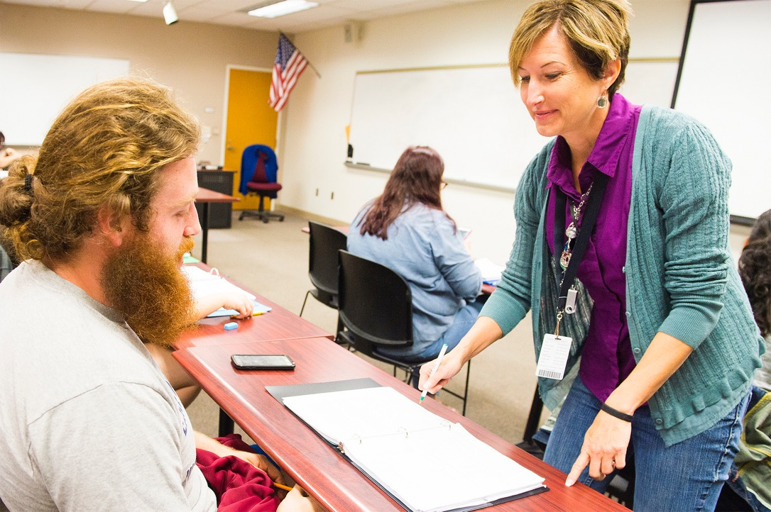
—Deborah Howard, Valencia College (Florida)

Slide 88
I encourage my students to set high standards for themselves. I do not settle for mediocrity, for being average, in my teaching, and by modeling this for my students I strive to inspire the same attitude in them.
—Graeme Lindbeck, Valencia College (Florida)

Slide 89
All students have the potential and talent to succeed. However, not all of our students have the same opportunity to develop those talents. The opportunity to serve as our students’ advocates and assist them in their educational journey inspires me to be a better version of myself.
—Jennifer Mezquita, Valencia College (Florida)

Slide 90
Going above and beyond to serve students—with a smile and a simple “How can I help you?”—is my opportunity to impact the future. Although applying for financial aid is only one step of the educational journey, it often makes the impossible possible.
—Kali Brown, Vance-Granville Community College (North Carolina)

Slide 91
The exceptional teacher is one who cultivates in students the confidence and desire to genuinely succeed within the confines of her classroom and far beyond. She requires that her students work for and earn every last point, demonstrating her belief in their abilities even before they believe in themselves.
—Kristi Salmons-Ellenberg, Vance-Granville Community College (North Carolina)

Slide 92
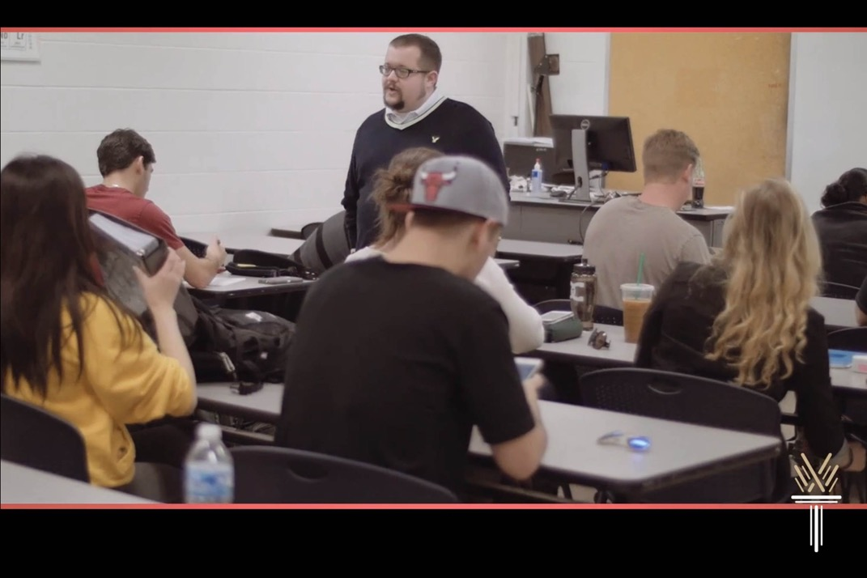
Posing questions is a lost art and can be seen as admitting to weakness or lack of knowledge. I strive to get students to embrace their questions and curiosity by maintaining an open, judgment-free, and approachable classroom that employs tech and real-world examples to make science tangible.
—Jason Whitehead, Wake Technical Community College (North Carolina)

Slide 93
O’Banion’s and Tinto’s ideas motivate my work as it applies to the goal of improved student success and completion through effective placement, engagement, relevancy, and cross-disciplinary instruction.
—Beth Johnson, Wallace State Community College (Alabama)

Slide 94
I’ve had the good fortune to experience many transformational moments because I work every day in an environment focused on changing lives for the better. It’s what we do.
—Johnny McMoy, Wallace State-Hanceville (Alabama)

Slide 95
It is my belief that education is what you do in your free time; learning must never end. It is my goal and pleasure to share my enthusiasm and passion for education with my students while providing them the skills that they need to be successful in their careers.
—Sarah Alamilla, Waukesha County Technical College (Wisconsin)

Slide 96
The transition each student makes from first-day EMT student to graduating paramedic is amazing. Think about this—each student goes forth and touches countless lives in immeasurable ways based on the foundation we provide. I would let any of them care for my family.
—Gary Bonewald, Wharton County Junior College (Texas)

Slide 97
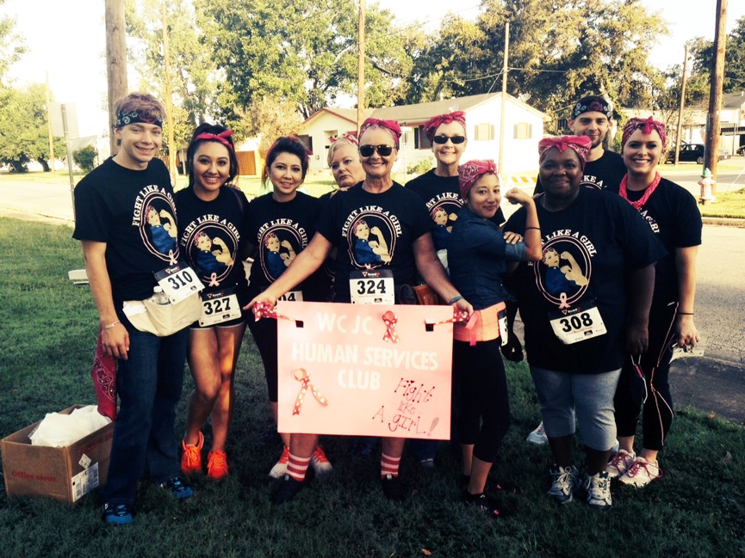
Mastering one's environment and determining one's keys to learning facilitates and stimulates growth, motivation, and determination, unlocking the quest for knowledge inside and outside the classroom. Teaching provides a unique opportunity to provide tools of learning in order for students to master and implement knowledge in their everyday lives.
—Victoria Schultz, Wharton County Junior College (Texas)

Slide 98
Whether it is helping a struggling student, teaching an online course, or establishing an employer partnership, seeing our students sharpening their professional skills with education has been the greatest gift. Each day, I encourage students to realize their potential, helping them build leadership, managerial skills, and confidence.
—Joy D'Angelo, Yavapai College (Arizona)

Slide 99
I am proud to be part of Zane State College. My goal is to provide students the skills needed to transition from the academic to the real world, and to see Zane State College as a milestone on a lifelong journey in pursuit of knowledge and career growth.
—William Klinesmith, Zane State College (Ohio)

Slide 100
“Excellence begets excellence. Students will rise to each occasion if you set the bar high and give them the tools and encouragement to reach it! Mediocrity isn’t good enough. I am challenged every day to model personal and professional behaviors to which my students may aspire. Ultimately they inspire me!”
—Lori Wahl, Zane State College (Ohio)

